Slide 1
KOLKATA PIZZA DELIVERY
Search Pizza
Login / Sign
Add to cart and confirm
ARPIT ANAND
Roll – 30000113005
Reg: 133000110005
Order Now !!

Slide 2
INTRODUCTION
This website is BAISC KOLKATA PIZZA DELIVERY , in which a user can book a pizza update it and order it,
and update the cart and order it.
Application provide the features FOR ADMIN , like an admin can create the pizza uploading the pictures and after that they can update and delete it.
01
02
03
04
CURD App for Admin.
User Login/Signup
Cart Update by User
Successful order to admin

Slide 3
Basic Features of the Application
User
A user can come from the pizzas , they could select one pizza.
Add to cart the pizza , and update.
Remove the pizza and can successfully order it.
Admin
Admin has a basic CURD Features like can add a new pizza with images , Update the pizza details , Remove.
Order got can be reviewed and can be confirm the order.

Slide 4

ANGULAR.JS
HTML , CSS
SKILL: Overview
PHP 5.4
SQL
FRONT END :
HTML 4/5, CSS 3, ANGULAR.JS , JAVASCRIPT
FRONT END :
ANGULAR.JS
BACK END :
PHP , MySQL
DESIGN :
MATERIAL DESIGN

Slide 5
SKILL: Overview
CSS: CSS is the acronym for "Cascading Style Sheet", design language helps to simplify the webpage creations.
ANGULAR.JS :AngularJS is a very powerful JavaScript Framework. It is used in Single Page Application (SPA) projects. It extends HTML DOM with additional attributes and makes it more responsive to user actions. AngularJS is open source, completely free, and used by thousands of developers around the world.
PHP : The PHP Hypertext Pre-processor (PHP) is a programming language that allows web developers to create dynamic content that interacts with databases. PHP is basically used for developing web based software applications.
SQL : SQL is a database computer language designed for the retrieval and management of data in relational database. SQL stands for Structured Query Language.

Slide 6
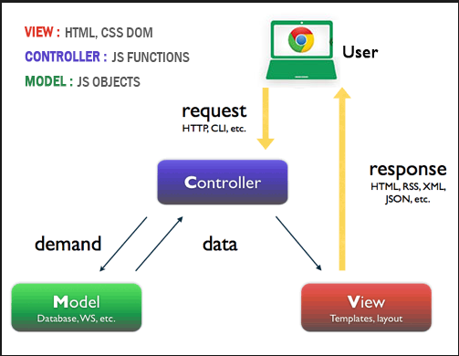
MVC ARCHITECTURE
MODEL
It responds to the request from view and to the instructions from controller to update itself.
MODEL
View
A presentation of data in a particular format, triggered by the controller's decision to present the data.
CONTROLLER
MODEL
The controller responds to user input and performs interactions on the data model objects

Slide 7
TOOLS REQUIRED
WampServer is a Windows web development environment. It allows you to create web applications with Apache2, PHP and a MySQL database. Alongside, PhpMyAdmin allows you to manage easily your databases
WAMP SERVER
TEXT-EDITOR
Text Editor is a sophisticated text editor for code, mark-up and prose , user interface, extraordinary features and amazing performance.
phpMyAdmin is a free software tool written in PHP, intended to handle the administration of MySQL over the Web. phpMyAdmin supports a wide range of operations on MySQL and Maria DB
PHPMYADMIN :DB
Hardware
A computer/ Laptop Ram : 1 Gb , Hard disk minimum 250 Gb

Slide 8
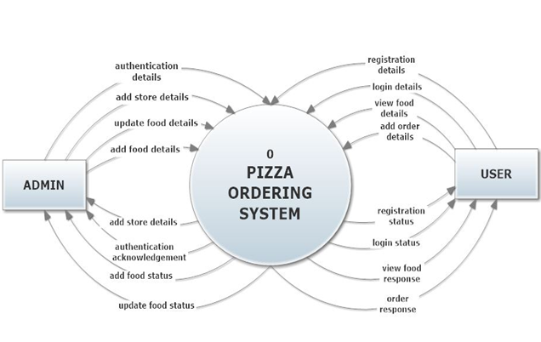
Level 0 Data Flow Diagram / Context Diagram

Slide 9
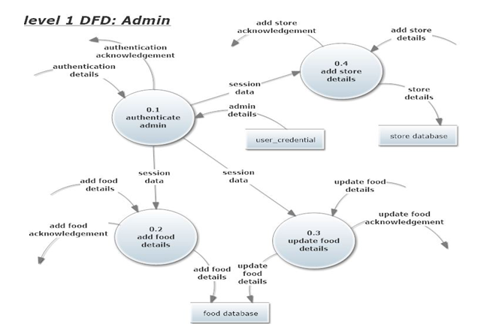
Level 1 Data Flow Diagram / Top-level Diagram

Slide 10
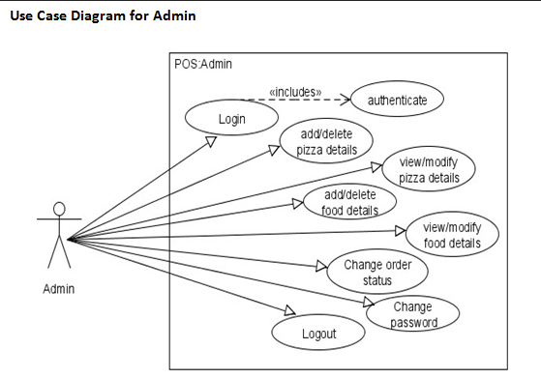
Use Case Diagram : admin

Slide 11
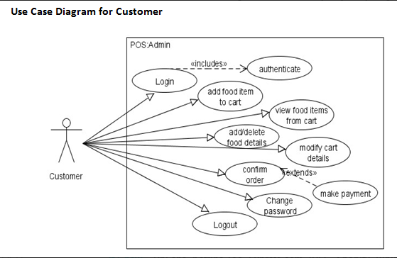
Use Case Diagram : Customer

Slide 12
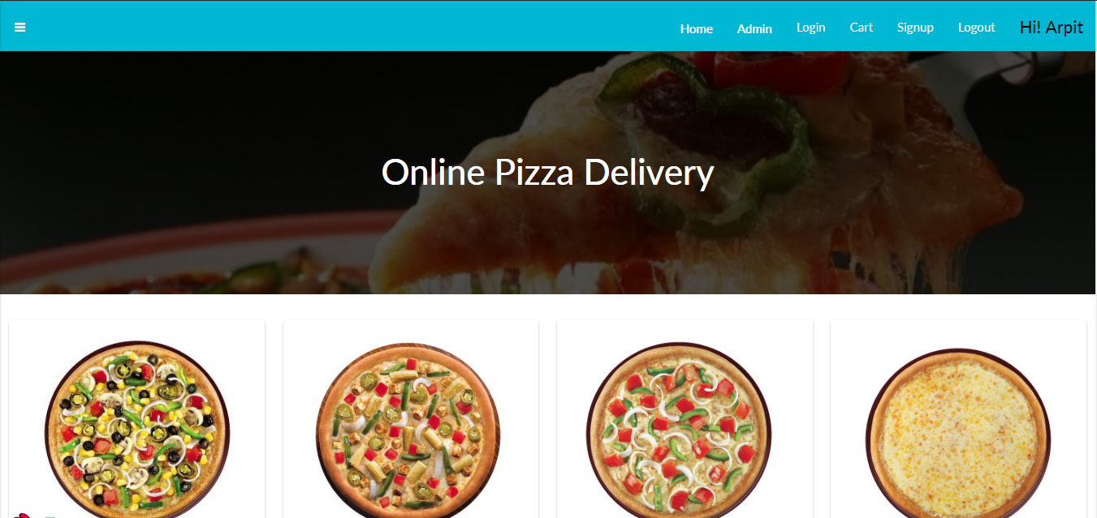

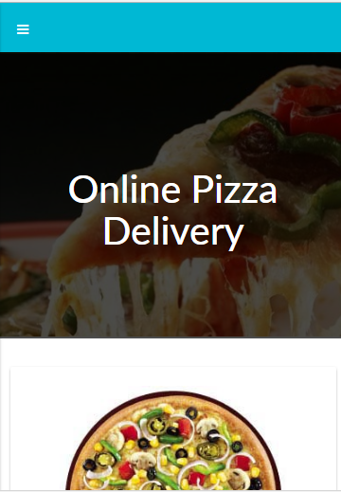
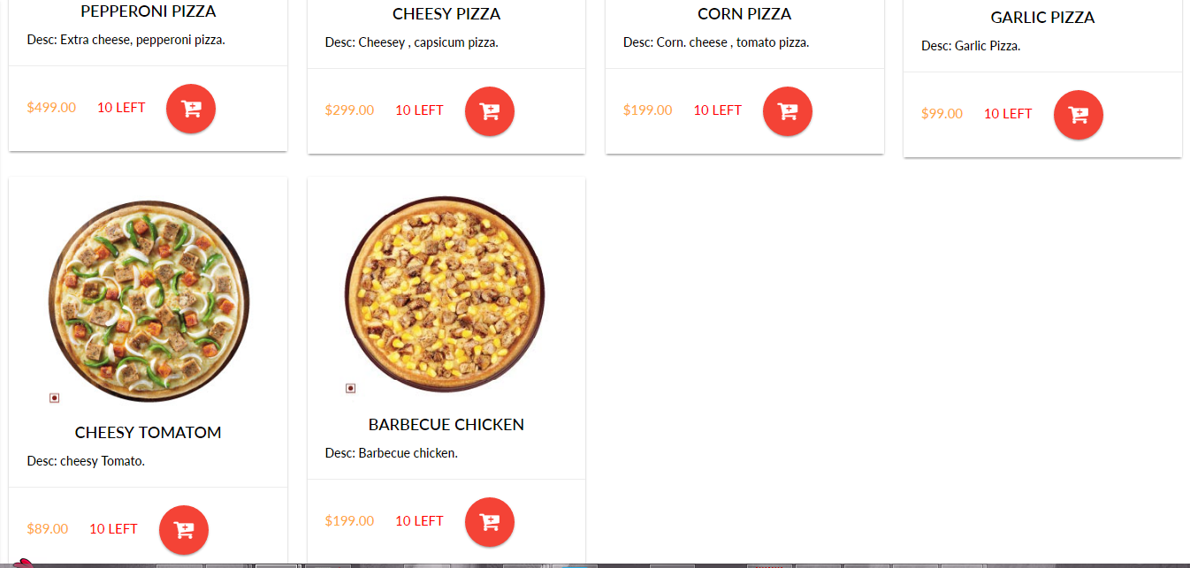
SNAPSHOT

Slide 13
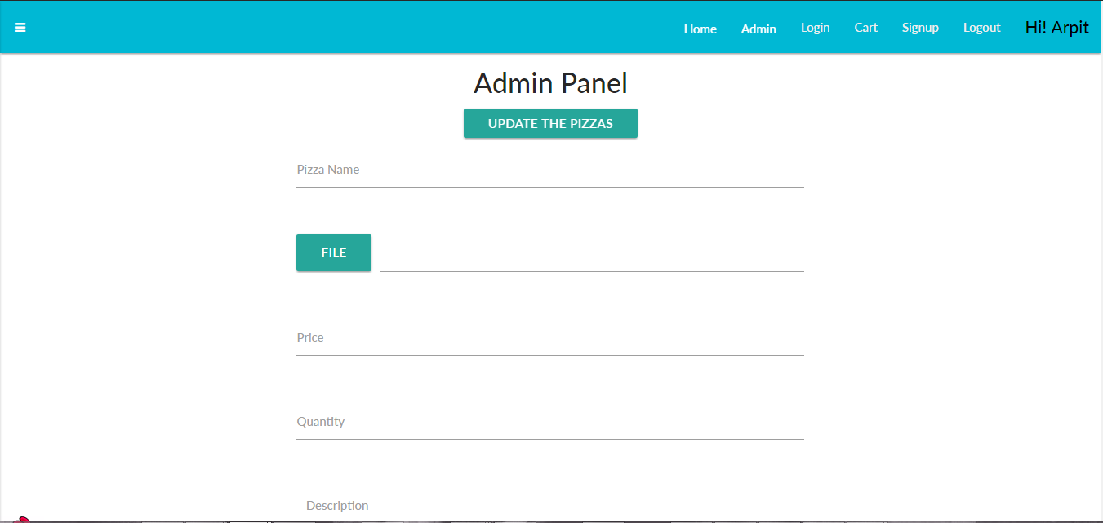
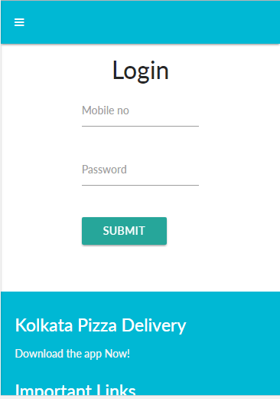
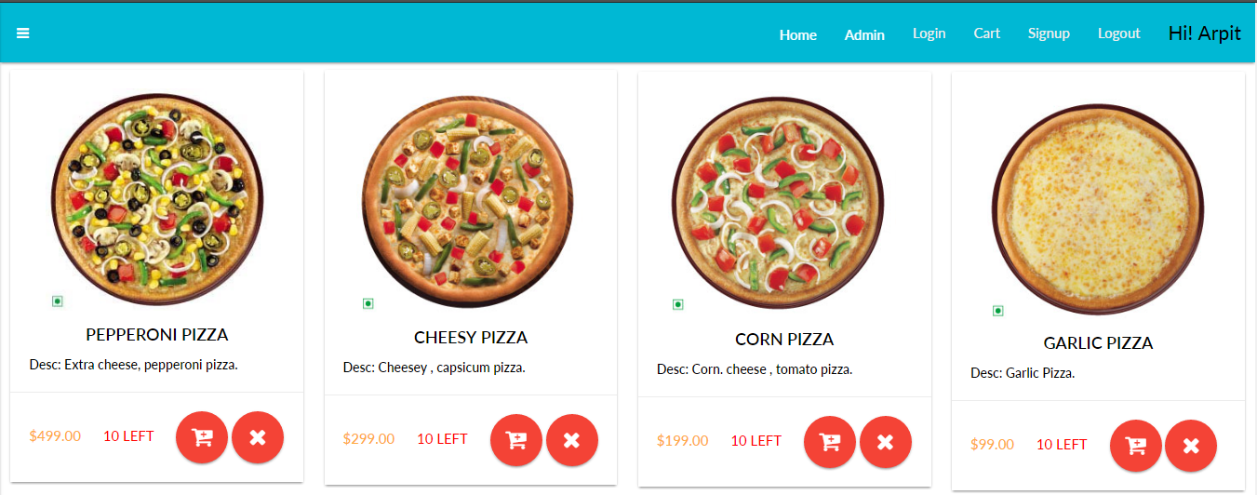

Slide 14
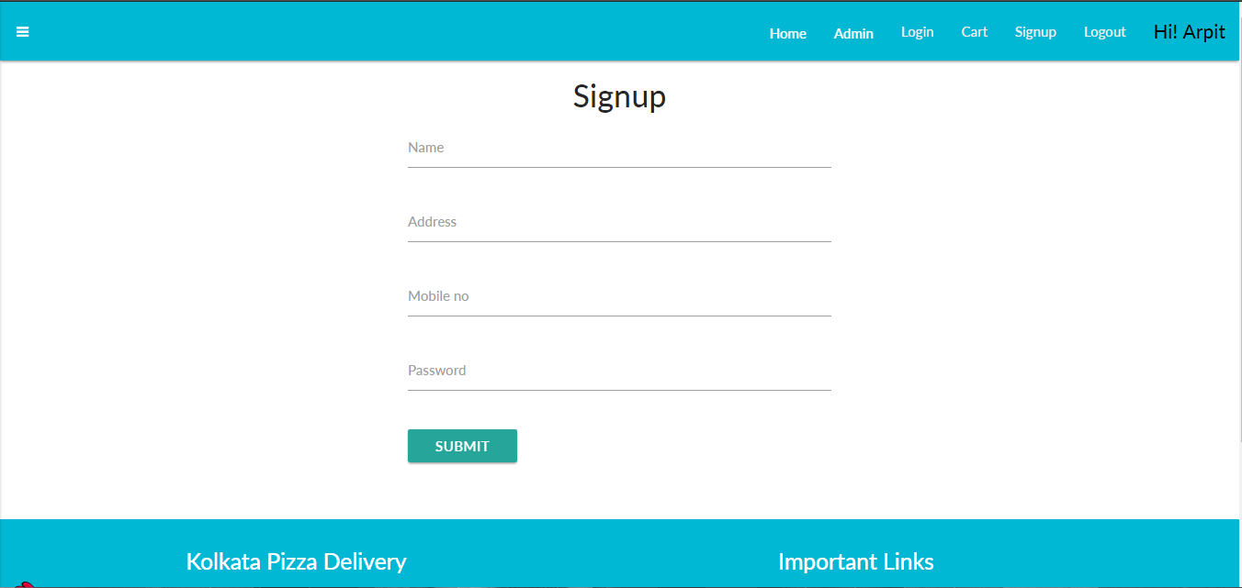
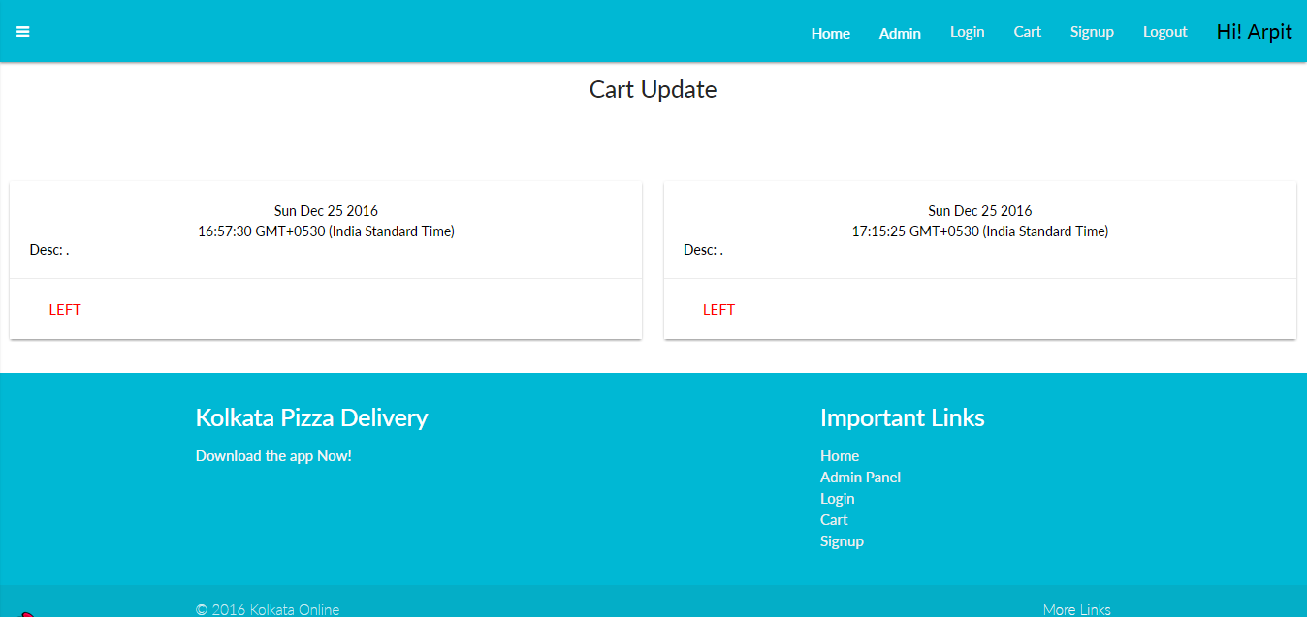
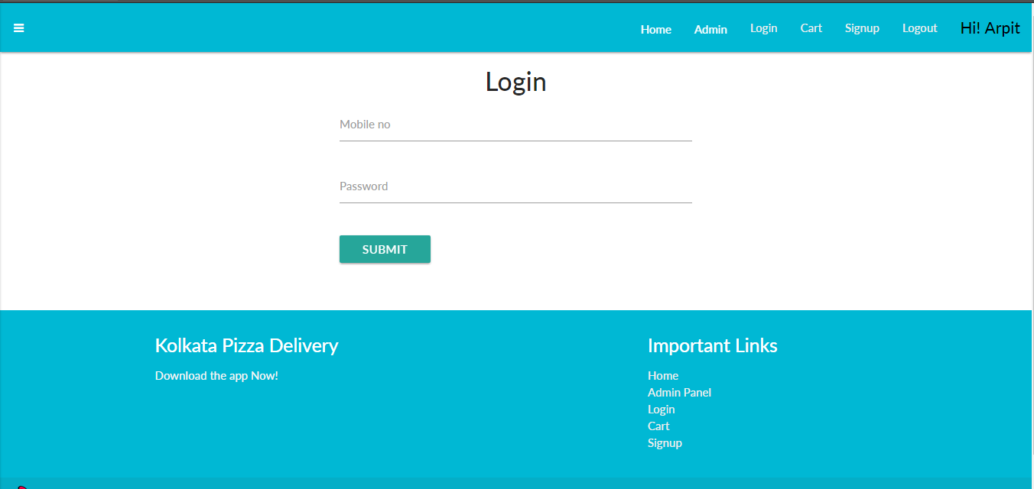

Slide 15
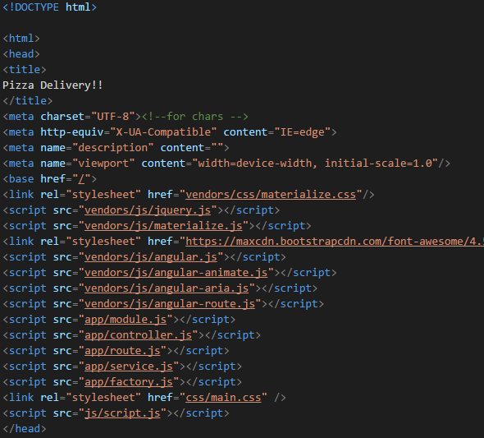
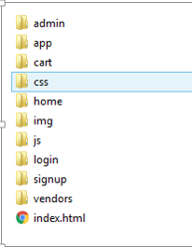
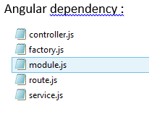
Code

Slide 16
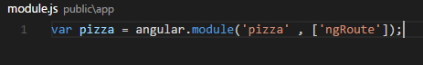
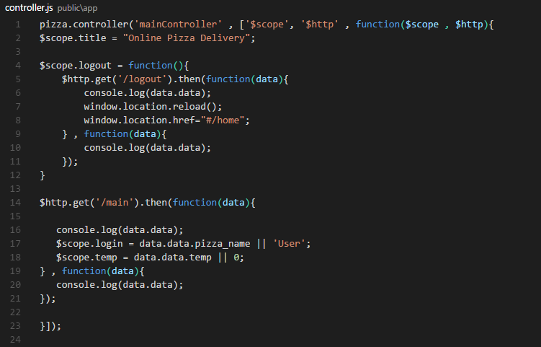

Slide 17
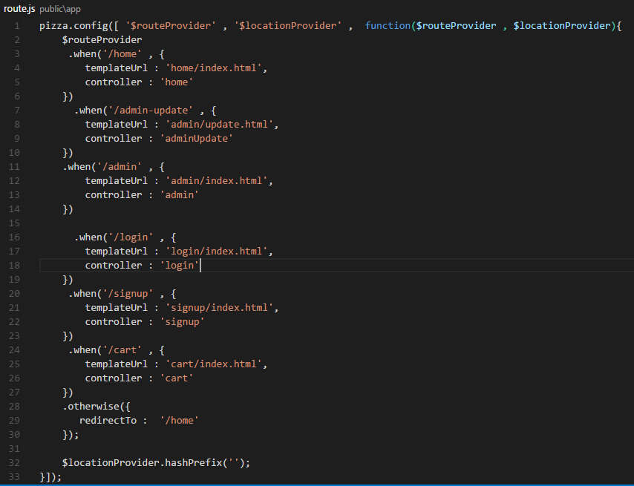

Slide 18
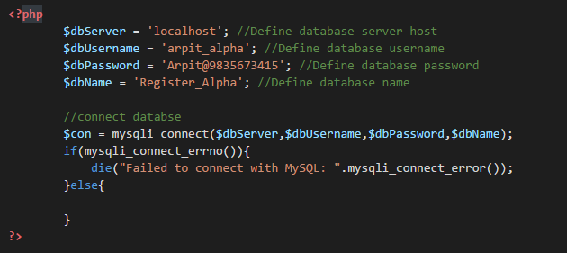

Slide 19
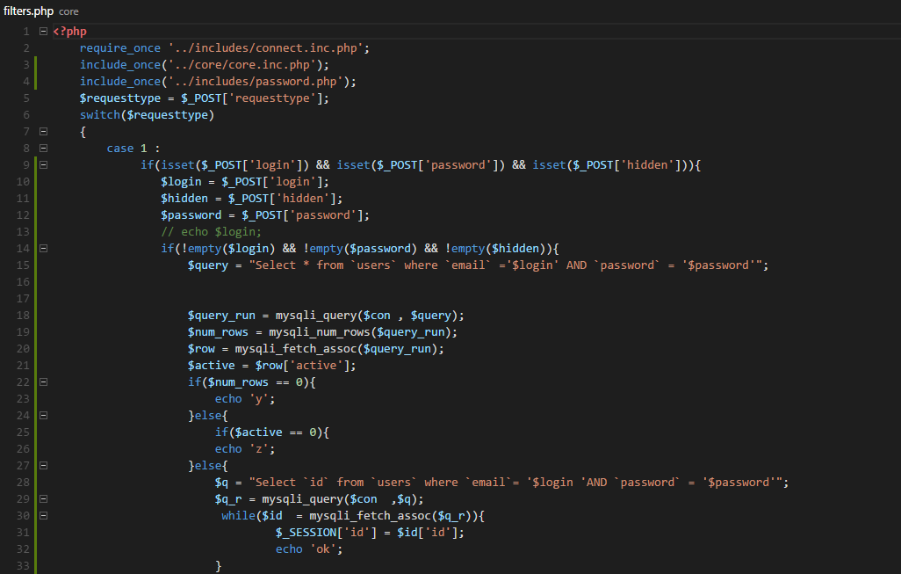

Slide 20
CONCLUSION
We have successfully completed the web application of TOPIC pizza delivery, has any features.
I got to learn various FRONT-END and BACK-END Technology and many design topic.
Since , A Database was involved , so it has a basic client-server model and Web Services and REST Api.
I also followed some of the SDLC and got to learn basic features of the software development.
In future , I should be able to apply all these technologies and knowledge and in successful in implementing this type of software development.

